Slide 1
ArchGen AI
Cloud-Native AI Architecture Generation Platform on Microsoft Azure
Cloud-Native Azure Deployment
Infrastructure as Code using Terraform Azure App Services & Cosmos DB
Ollama LLM on Azure VM
Secure Networking & Application Gateway Enterprise-Grade WAF Protection
Praveen Eswar M

Slide 2





I Cloud Implementation Objectives
SaaS Scalability
Build a scalable cloud-native platform using Azure's managed services for elastic growth.
IaC Automation
Eliminate manual configuration by automating the entire resource lifecycle via Terraform.
Zero Trust Network
Implement secure segmentation using VNets, Private Endpoints, and WAF protection.
AI Workloads
Host and manage Ollama LLM effectively on optimized Azure Virtual Machines.
Design Consistency
Improve deployment speed and consistency with reusable architecture modules.

Slide 3
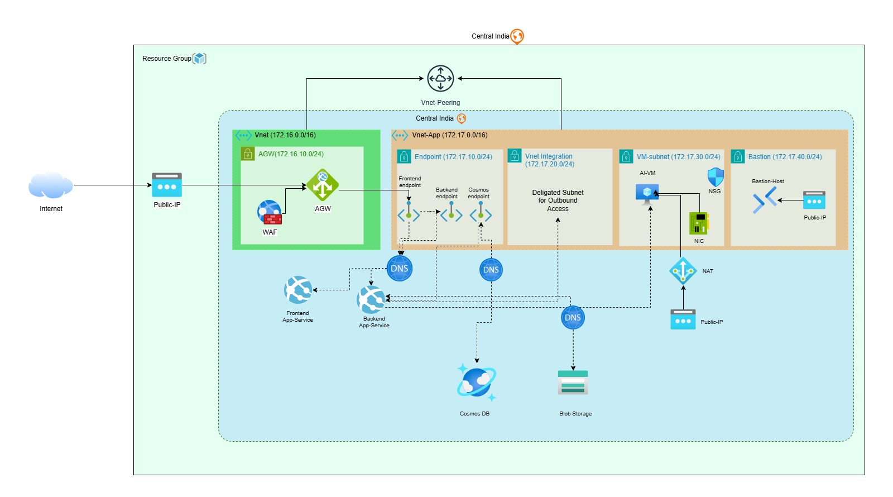
_{I} Azure Cloud Architecture

Slide 4
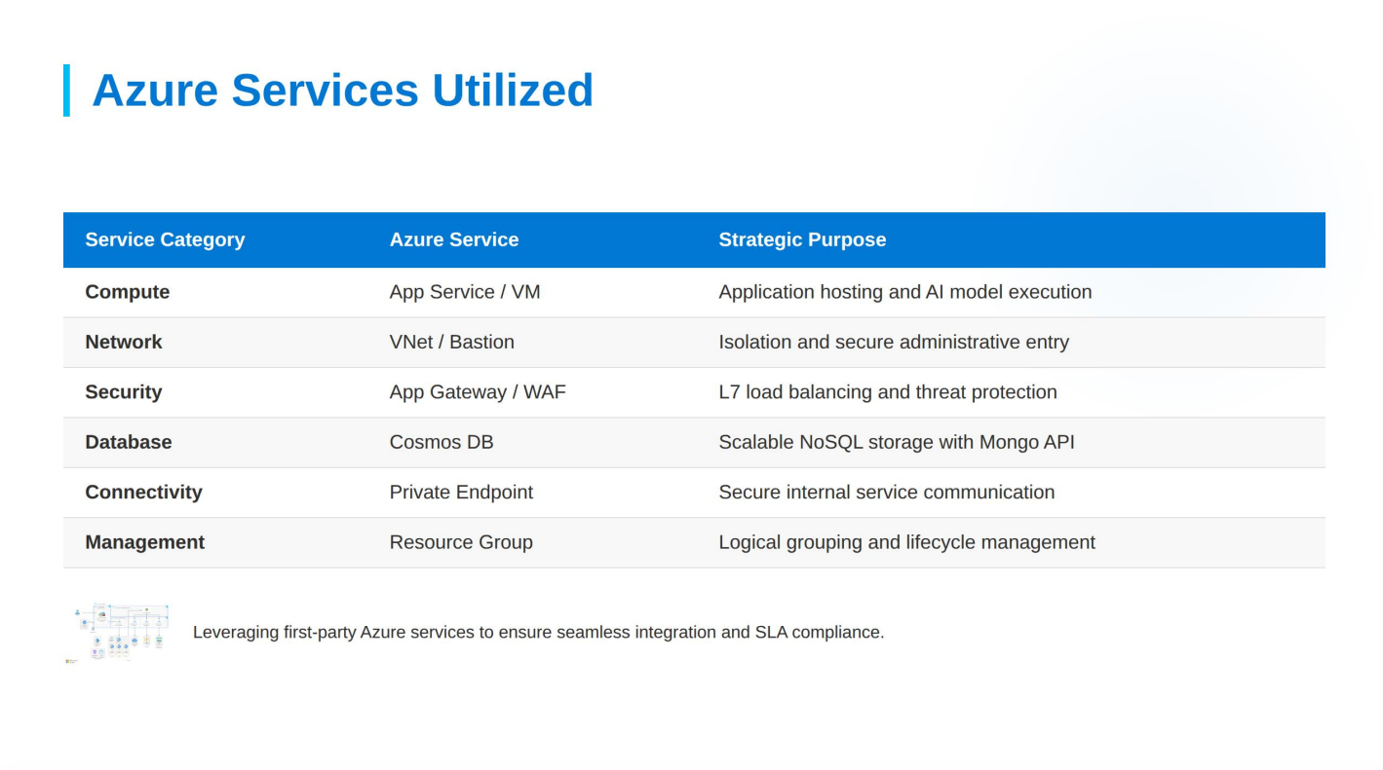
I Azure Services Utilized
Compute | App Service / VM | Application hosting and AI model execution
Network | VNet / Bastion | Isolation and secure administrative entry
Security | App Gateway / WAF | L7 load balancing and threat protection
Database | Cosmos DB | Scalable NoSQL storage with Mongo API
Connectivity | Private Endpoint | Secure internal service communication
Management | Resource Group | Logical grouping and lifecycle management
Leveraging first-party Azure services to ensure seamless integration and SLA compliance.

Slide 5
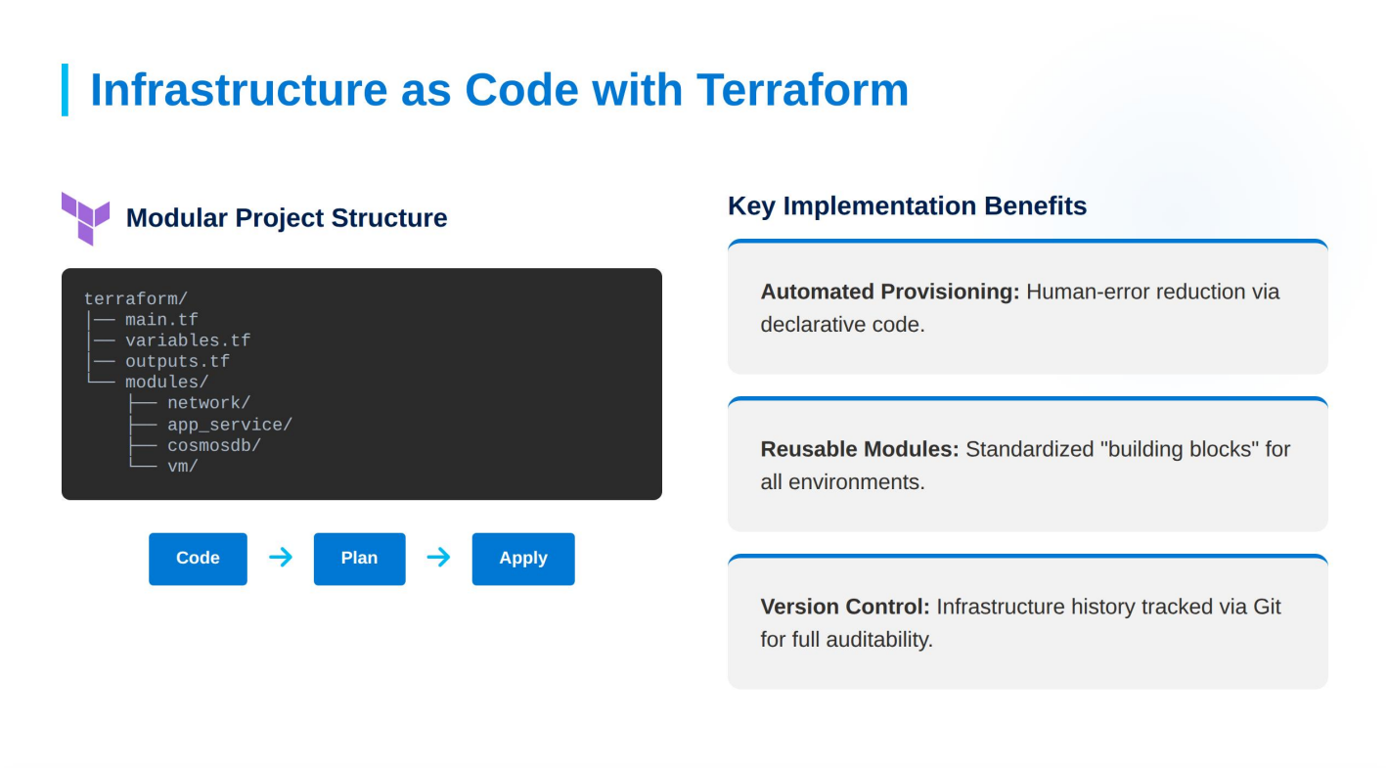





_{I} Infrastructure as Code with Terraform
Modular Project Structure
Key Implementation Benefits
Automated Provisioning: Human-error reduction via declarative code.
Reusable Modules: Standardized "building blocks" for all environments.
Version Control: Infrastructure history tracked via Git for full auditability.

Slide 6
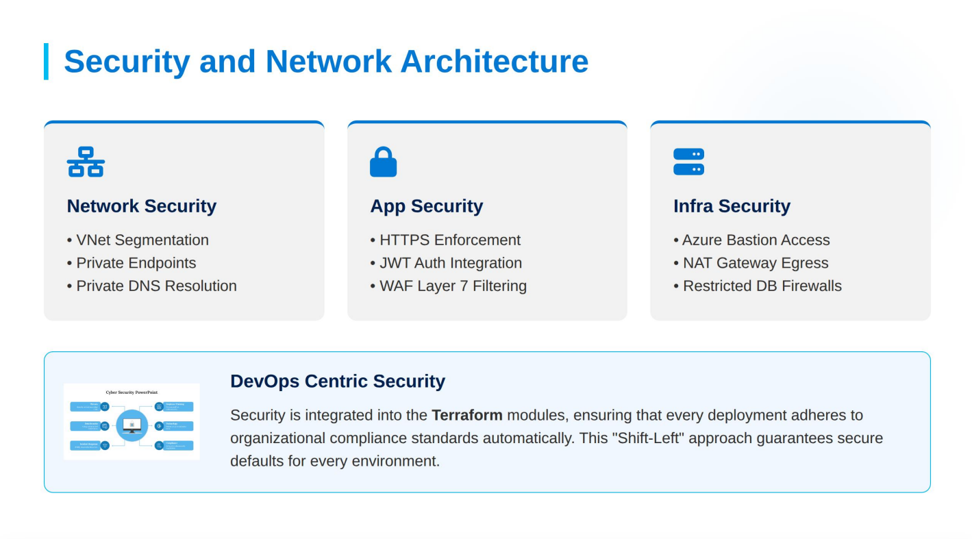



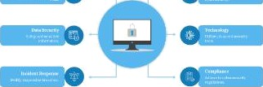
Security and Network Architecture
Network Security
VNet Segmentation
Private Endpoints
Private DNS Resolution
App Security
HTTPS Enforcement
JWT Auth Integration
WAF Layer 7 Filtering
Infra Security
Azure Bastion Access
NAT Gateway Egress
Restricted DB Firewalls
DevOps Centric Security
Security is integrated into the Terraform modules, ensuring that every deployment adheres to organizational compliance standards automatically. This "Shift-Left" approach guarantees secure defaults for every environment.

Slide 7
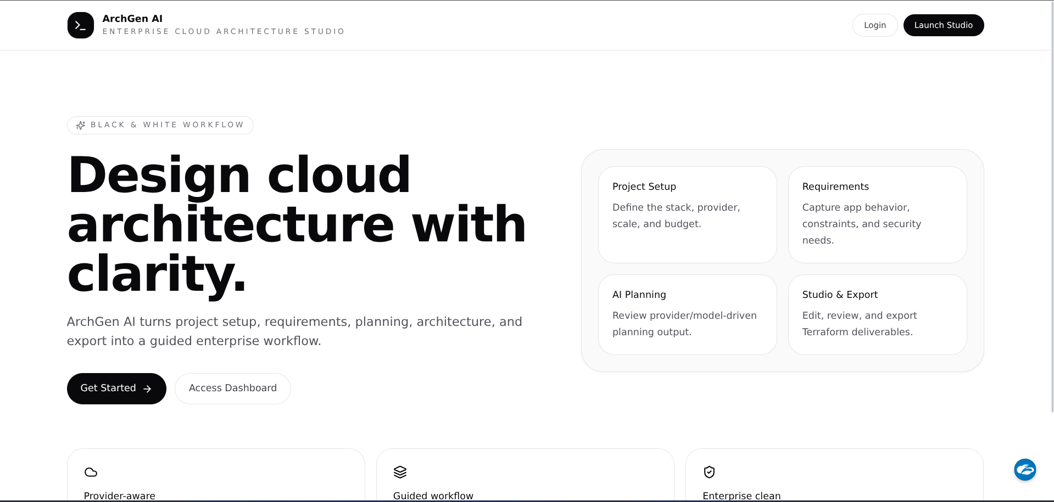


I Outcome
_”
https://learn.microsoft.com/en-us/azure/architecture/example-scenario/aks-agic/media/aks-agic.svg
Source: learn.microsoft.com
"-°, .
“ Thumbnail
I£ '¿trn. micros .
://learn.microsoft.com/en-us/azure/architecture/icons/images/baseline-app-service-architecture.svg
learn.microsoft.com
https://cdn.jsdeIivr.net/gh/homarr-labs/dashboard-icons/png/hashicorp-terraform.png
Source: dashboardicons.com
'O
https://www.slideegg.com/image/catalog/20627-cyber-security-powerpoint-template-blue.png
source: www.sIideegg.com
https://site-cdn.core.nytro.ai/static/media/0d7d1ba7-ab56-4dbe-bc7a-e14d91817abf.jpeg?_cb=1695736567.4629567
Source: infohub.deIItechnoIogies.com

Slide 8
Thank You!

